Slide 1
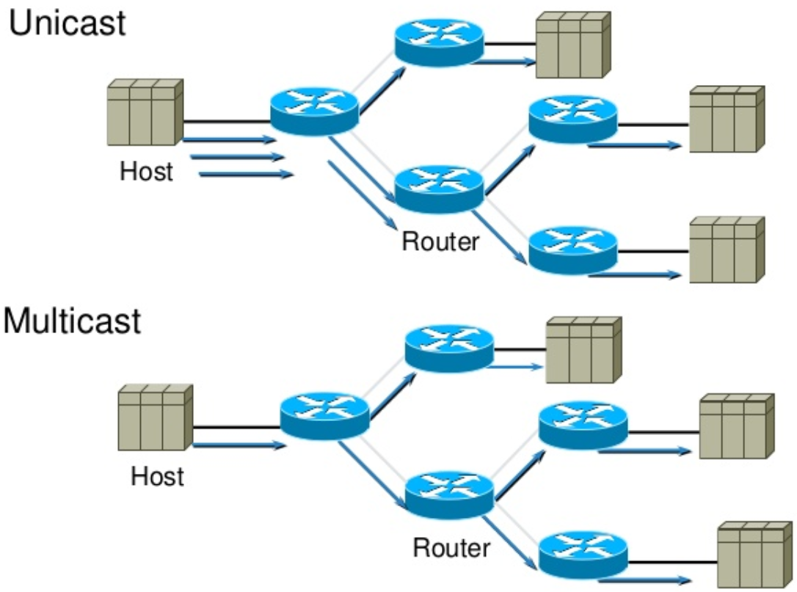
Distance Vector Multicast Routing Protocol (DVMRP)
Multicast routing protocol, RFC1075 (1988).
Used in first internet multicast backbone (MBONE, 1992).
IPv4 address types: unicast, broadcast, multicast.
Not connection-oriented, best-effort delivery (IP).
Not guarenteed to reach all group members.
Hosts are free to join or leave a group at any time.
Sender need to be aware of group members.
Multicast conserves bandwidth by forcing network to do packet replication.
Radio / VIdeo broadcasts, Video conferencing, Distance learning
Shared applications, Multiplayer gaming, Chat rooms
Advertisements, Stocks, Distributed databases

Slide 2
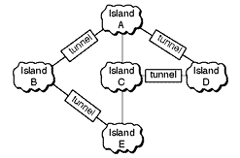
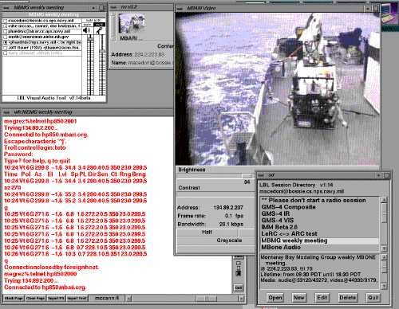
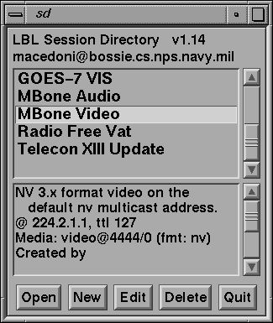
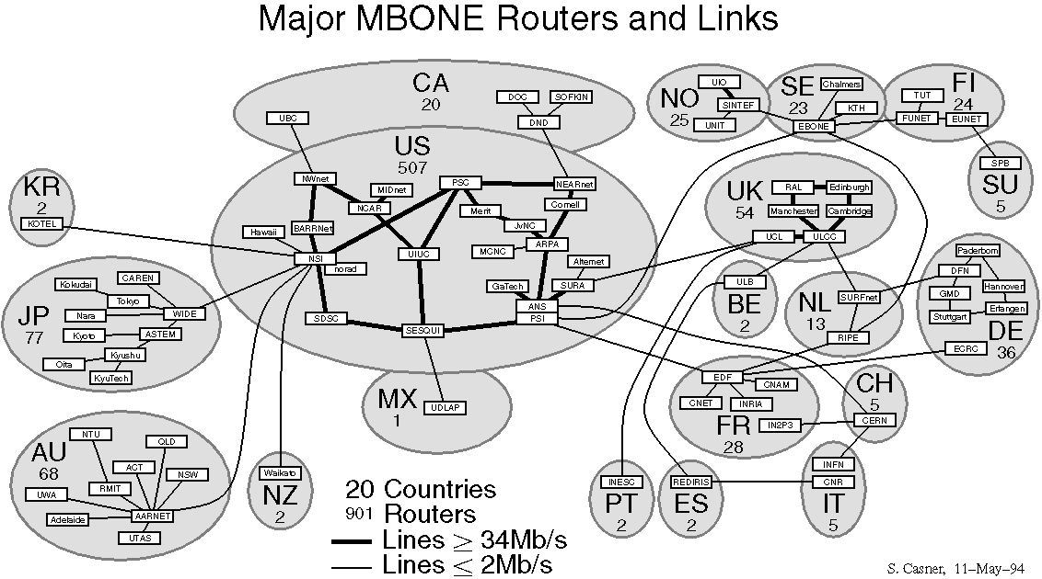
Multicast Backbone (MBONE)
Interconnected subnetworks and multicast routers.
Created by Jacobson, Deering, Casner (1992).
Uses tunnels for connecting through unicast routers.
Uses DVMRP, MOSPF for routing along with IGMP.
IP Address: 224.2.0.0 (audio 64kbps, video 120 kbps)
IETF meetings, US House & Senate sessions
NASA Space shuttle missions, Satellite weather photos
1992: 40 subnets in 4 countries
1993: Live band performance by Severe Tire Damage
1995: M-bone links in Russia, Antarctica
1996: 2800 subnets in 25 countries
2008: Virtual video conferencing system in use

Slide 3
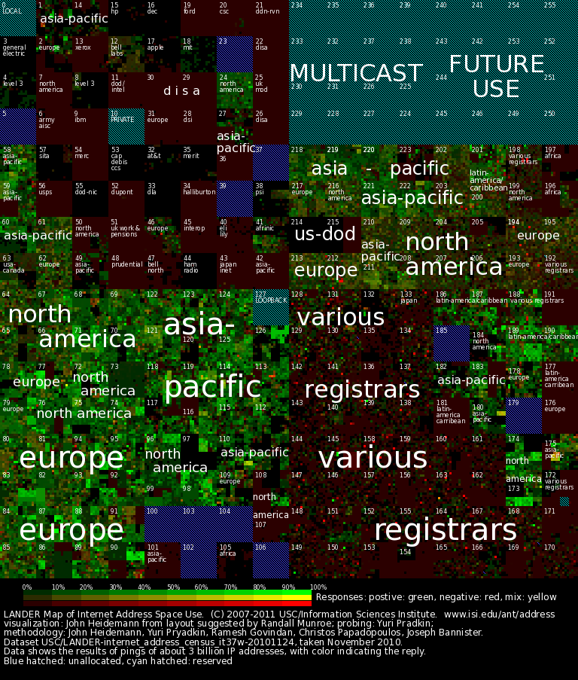

Multicast Addressing
Class D IP addresses are used for multicast.
Start with "1110" followed by 28-bit group ID.
Fixed vs Transient multicast IP (logical address).
224.0.0.0: Reserved Class D
224.0.0.1: All multicast devices
224.0.0.2: All multicast routers
224.0.0.4: All DVMRP routers
224.0.0.5: All OSPF routers
224.0.1.11: IETF-1-Audio
224.0.1.12: IETF-1-Video
224.0.0.255: Last reserved for routing
239.0.0.0: Site-local applications
239.255.255.255: Last Class D

Slide 4
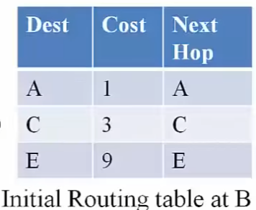
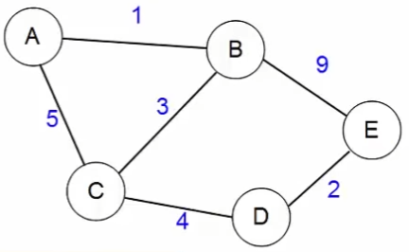
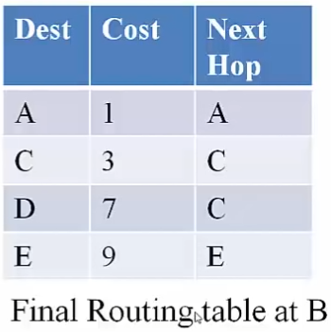
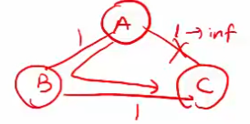
Distance Vector Routing (eg. RIP)
Find the least cost path between 2 nodes.
Also called Bellman-Ford algorithm (distributed).
Each node maintains a routing table.
Originally used in ARPAnet, RIP (now used rarely).
Initial: Distance (cost) to its neighbours is known.
Goal: Distance to all neighbours & next-hop known.
Routing table info is shared with neighbours (except next-hop).
On receiving message, routing table updated with min-cost path.
After N rounds, N+1 hop paths become known.
Triggered update: link / node failure or cost change
Periodic update: Still alive, update DV if some route becomes invalid
Periodic update helps when a route becomes invalid
Bellman-Ford distance update equation

Slide 5
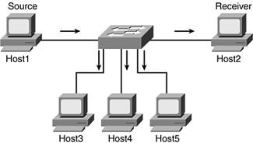
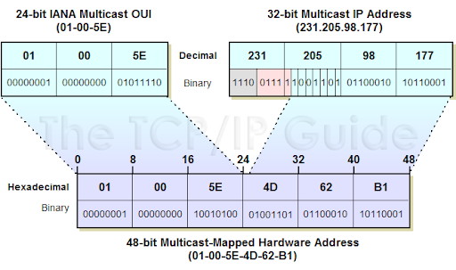
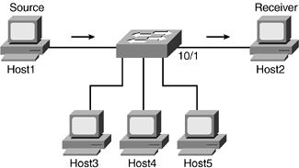
Multicast Flooding
Router / Host sends packet on all interfaces.
If router has been seen packet before, its discarded.
Used on local network for multicast communication.
Filtering can be done with Multicast MAC address.
Each Host Receives the Multicast Stream
Multicast Stream is filtered by Switch through Multicast MAC address

Slide 6
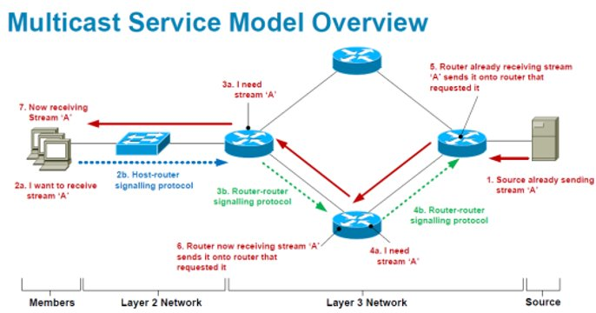
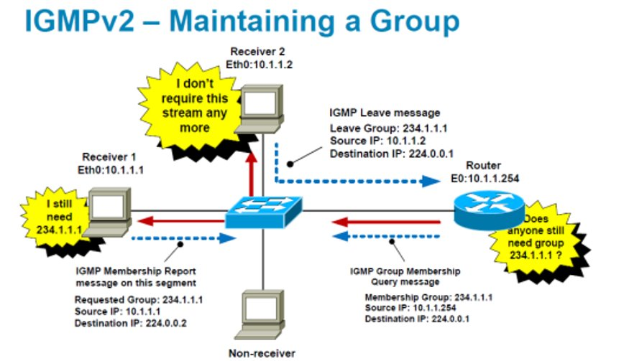
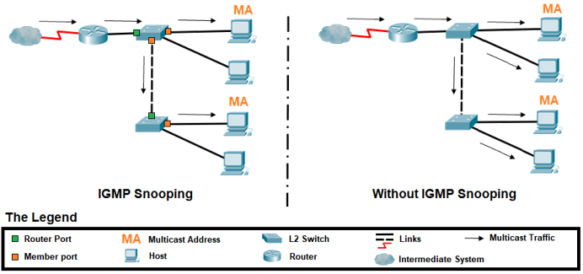
Internet Group Management Protocol (IGMP)
Hosts tell router about group membership (RFC 1112).
Router uses this to help route multicast packets.
Filtering can be done with IGMP snooping by switch.
Report: Host says to router, "I want to receive multicast data for X.X.X.X".
Query: Router asks hosts, "Is anone still interested in data for X.X.X.X"?
Report is sent to address X.X.X.X, and received by other members & router.

Slide 7
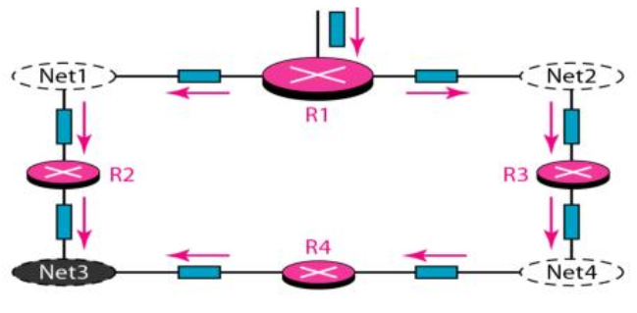
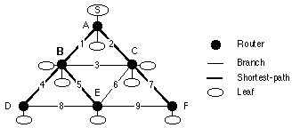
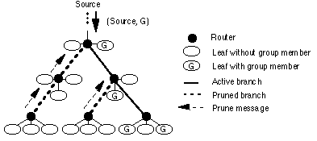
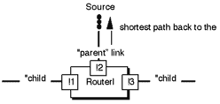
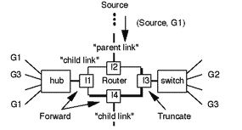
Reverse Path Multicasting (RPM)
Net3 recieves 2 packets
Forward packet that arrives on shortest path to source.
Router discards packet if it arrives on any other interface.
Delivery tree is truncated if leaf subnet has no members.
Prune message is sent if all child links are truncated.
Opt: Forward only if on downstream router's shortest path.
Duplicates are possible since shortest path is source-based.
RPB
TRPB
RPM
Opt. Reverse Path Broadcasting (RPB)
RPB
Reverse Path Broadcasting (RPB)
Truncated Reverse Path Broadcasting (TRPB)
Reverse Path Multicasting (RPM)

Slide 8
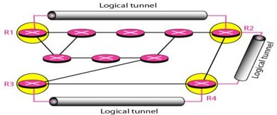
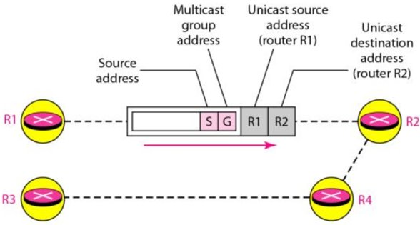
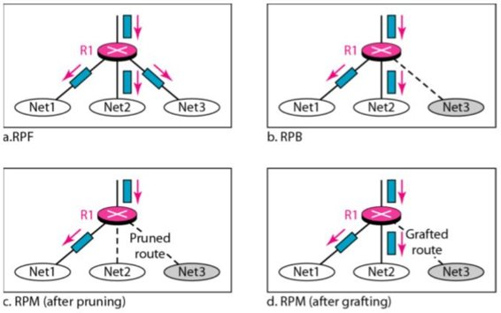


DVMRP
It is a distance vector multicast protocol, like RIP.
Suitable for use within autonomous system.
Tunnels are used between non-multicast routers.
Routers need to run a unicast protocol too.
Reverse path multicasting (RPM) used between routers.
Intially (S,G) packet is broadcasted using TRPB.
IGMP is used to find group members in subnets.
Routers send prune message to parent if subnet has no group member.
Routers send graft message to parent if subnet has new group member.
DVMRP, MOSPF, PIM: within Autonomous System
MBGP: between Autonomous Systems
DVMRP Routing table
DVMRP Forwarding table

Slide 9
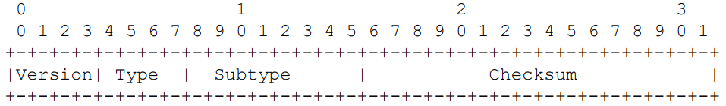
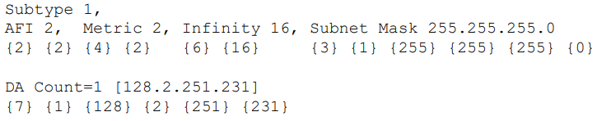
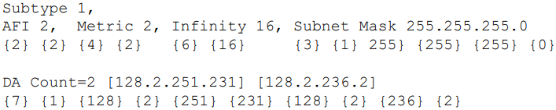

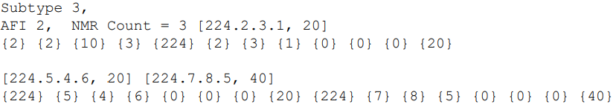
DVMRP Datagrams
DVMRP header
DVMRP uses IGMP to exchange routing datagrams (type 3).
Message is a stream of tagged data (key=value, … max 512B).
Routers provide periodic and triggered updates.
Messages sent to multicast address 224.0.0.4 (TTL=1).
Request: request route to sources
Response: provide route to sources
Non-membership report: prune path for T seconds (no member)
Non-membership cancellation: graft path (new member)
NULL, Flags0, Infinity, Metric
Address Family Indicator (AFI), Subnet mask
Destination Address (DA)
Requested Destination Address (RDA)
Non Membership Report (NMR)
Non Membership Report Cancel (NMR Cancel)
Response of route for 128.2.251.231 with metric 2, INF=16, SM=255.255.255.0
Subtypes
Response of route for 128.2.251.231 & 128.2.236.2 with metric 2, INF=16, SM=255.255.255.0
Request all routes (to source).
Commands
NMR for groups 224.2.3.1 & 224.5.4.6 (20s), 224.7.8.5 (40s)

